Slide 1
Demystifying Health Insurance: Insurance 101 and Marketplace Overview
October 30, 2024

Slide 2
This webinar will be recorded.
Recording and slides will be shared.

Slide 3
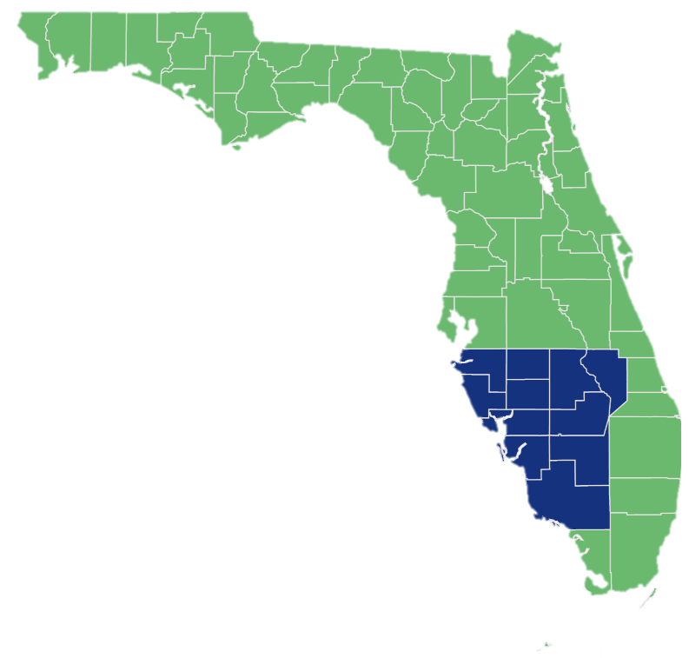
Who is the Health Planning Council of SWFL?
HPC’s Mission
HPC’s Programs
We are committed to improving the health and wellness of our community with PRIDE.
Providing & promoting early health intervention
Reducing health disparities
Increasing access to quality health-related services
Detecting & eliminating gaps in related services
Educating & collaborating
Early Intervention
Infant Mental Health
Health Planning
Healthcare Coalition
HPC Areas Served
ACA Navigator
Through its various programs, HPC serves 11 counties in southwest Florida including Charlotte, Collier, DeSoto, Glades, Hardee, Hendry, Highlands, Lee, Manatee, Okeechobee, and Sarasota Counties
HOPWA
The Health Planning Council of Southwest Florida is a 501(c)(3) non-profit organization. Most of our services are offered at no cost to the community.

Slide 4
Health Planning Services
Community Health or Topic-Based Assessments
Program and Project Planning Assistance and Evaluation
Education & Outreach
Organizational & Admin Services
Elements of an assessment may include:
Primary and secondary data analyses
Community surveys
Focus groups
Community leader interviews
MAPP Framework
Help to meet current and future funding requirements
Assist with the creation of educational and outreach materials and brainstorm and execute new community programming. We host monthly documentary screenings, create topic-based fact sheets, provide public health training, and produce the annual county health profiles.
Assistance can be provided to manage any coalitions and community groups. Able to act as a facilitator for a single meeting or provide ongoing administrative support for a program/project
Facilitate and guide the planning of programs or projects. We help set measurable objectives and can provide an evaluation of a project, grant, or program.
Hpcswf.com, email us at Planning@hpcswf.com

Slide 5
Health Planning Services
Strategic Planning
Tier 1
Tier 2
Tier 3
Successful organizations develop short and long-term goals to achieve sustainable growth. HPC provides levels of planning and research support tailored to your organization's needs, timelines, and objectives.
The process is interactive and engaging. Results are detailed and focused solutions that address the dynamic landscape of your community.
Half-day planning session:
Define target population
Review mission and vision
Quickly review selected data
Brainstorm strategies
Brief prioritization
Determine goals and objectives
Multi-session approach allows for research, external input, discussion, contemplation, and review,
3-4 planning sessions
Data collection and review
Survey of community, staff and/or Board of Directors
Interview with key individuals
Development of detailed goals and objectives with associated actions steps, measures, and owners
Most thorough process includes previous tiers but allows for additional elements to assist in the execution.
Implementation or operating plan
Case statement for fundraising
Marketing plan
Ongoing evaluation
Cost analysis of potential projects
Hpcswf.com, email us at Planning@hpcswf.com

Slide 6
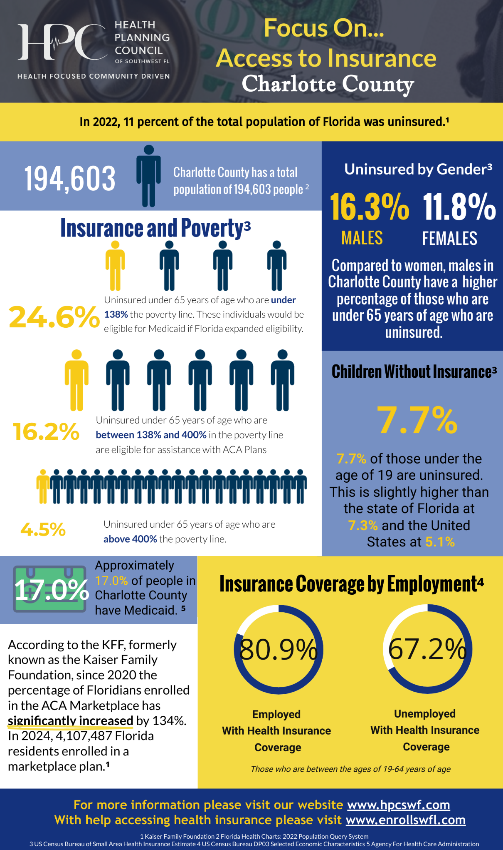
Newly Updated,
Access to Insurance Fact Sheet
Click here to access fact sheet
Hpcswf.com, email us at Planning@hpcswf.com

Slide 7
Join us for our next event!
What: Streaming Movie Series: Spilled Milk
When: November 21, 2024, 3:00pm
Where: Zoom
How to register: click here
Hpcswf.com, email us at Planning@hpcswf.com

Slide 8
How to Contact Us
Health Planning Council of Southwest Florida
ACA Navigators
Phone: 239-433-6700
Email: Planning@hpcswf.com
Website: Hpcswf.com
Phone: 1-866-547-2793
Website: Enrollswfl.com
Hpcswf.com, email us at Planning@hpcswf.com

